Slide 1



Converged HREDD Assessment Tool
Empowering Industries to Strengthen Human Rights and Environmental Due Diligence Practices

Slide 2

Welcome & introduction
Notes:
Louise

Slide 3
Anti-trust rules
The Association shall not enter into any discussion, activity or conduct that may infringe, on its part or on the part of its members, any applicable competition law.
By way of example, members shall not discuss, communicate or exchange any commercially sensitive information, including non-public information relating to prices, marketing and advertising strategy, costs and revenues, trading terms and conditions with third parties, including purchasing strategy, terms of supply, trade programmes or distribution strategy.
This applies not only to discussions in formal meetings but also to informal discussions before, during and after meetings
Notes:
Louise

Slide 4







Agenda and speakers
Louise Herring
AIM-Progress
Maria-Isabel Cubides
Consumer Goods Forum
Alain Nguyen
Nestlé
Richa Mittal
Fair Labor Association
Rebecca White
ProForest
Virginie Mahin
Mondelez International
James Cruickshanks
Smurfit WestRock
Notes:
Maria-Isabel

Slide 5


Why AIM-Progress & the Consumer Goods Forum have partnered on this tool

Slide 6


History of the tool
Notes:
Richa - FLA

Slide 7
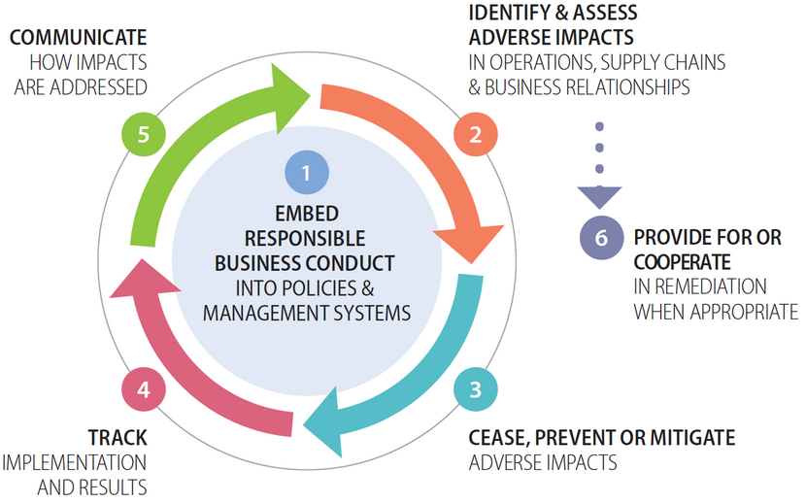
How this fits with the OECD framework/ UNGPs
A continuous process throughout which companies take action to identify and address risks and adverse impacts to people and the environment

Slide 8

Notes:
Bex - Proforest

Slide 9

















PARTICIPATING COMPANIES
MEMBER ORGANISATIONS & TECHNICAL PARTNERS

Slide 10


Objective
A tool that will allow companies, brands and suppliers to assess the maturity level of their HREDD management systems and use this as the basis of improving those systems.

Slide 11
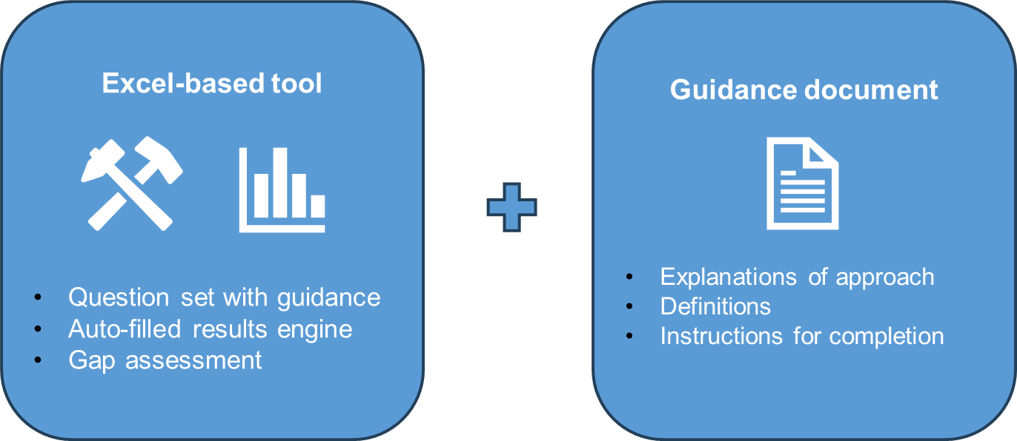
Tool & Guidance

Slide 12
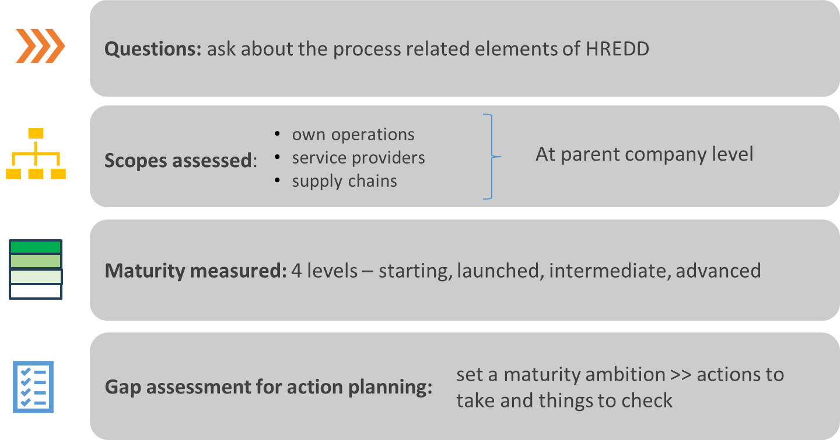
Tool Elements

Slide 13

Objective and insights
Used at parent company level
A tool that will allow companies, brands and suppliers to assess the maturity level of their HREDD management systems and use this as the basis of improving those systems.
For understanding HREDD maturity in own operations
For understanding maturity of HREDD you do on your supply chains
For identifying gaps in HREDD systems and supporting improvement
For informed supplier engagement on HREDD

Slide 14
Architecture
Own Operations Questions Tab
Answers: yes, in progress, no // Guidance against all questions // Evidence requirements
1. Corporate
Supply Chain(s) Questions Tab
Service providers
Up to 3 supply chains (e.g. high risk material/commodity supply chains)
POLICY
RISK ASSESS
TAKE ACTION
REMEDY
TRACK
REPORT
Results Tab
Results show performance per HREDD step for:
- Own operations, service providers and each supply chain answered for
- Human rights and environmental due diligence
Gap Assessment Tabs
Action Plan Template Tab
Use recommended HREDD requirements as the basis for action planning

Slide 15
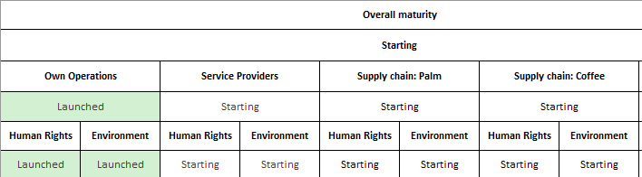
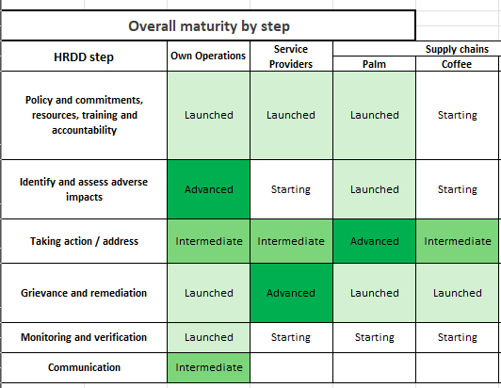

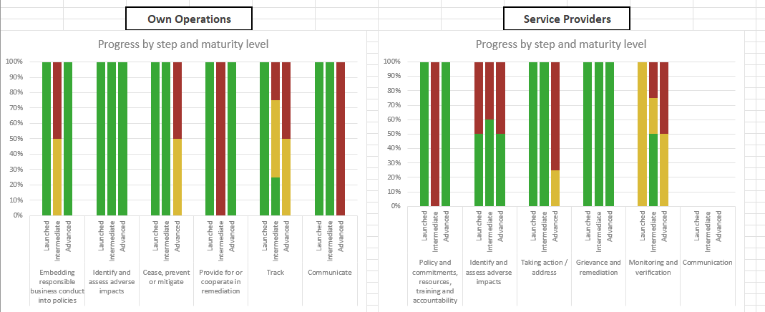


Process of completion & presentation of results
Choose supply chains
Answer 33-38 questions per scope
Review results
Set maturity level goal
Automated gap assessment
Develop an action plan
Overall maturity
Maturity breakdown per HREDD step
Actions implemented, in progress or not started

Slide 16
Recommendations on when to use this tool
For self-assessment
As part of your own company’s HREDD approach
With suppliers
Within an established relationship
Operating in higher risk geographies & production sectors, where the most salient issues lie
No existing suitable tool
Use the tool as part of supplier engagement as basis for open and constructive dialogue and support supplier to implement meaningful HREDD systems

Slide 17
Company testimonies
Alain Nguyen
Nestlé
Virginie Mahin
Mondelez International
James Cruickshanks
SmurfitWestRock

Slide 18

What happens next – launch into implementation phase
Notes:
Available through our websites
Further discussions about deployment
Sharing with key stakeholders & getting feedback
Rollout through AIM-Progress supplier capability building work
Discussions with platforms like Sedex & Ecovadis
12 month timeframe –revisit in 2025
Reinforce the origins about coming together
Use the tool
Verification can be used with certain members
Action planning
Support to suppliers

Slide 19

Q&A

Slide 20
Contacts, feedback & further information
AIM-Progress – tool link here | https://aim-progress.com/ | info@aim-progress.com
Consumer Goods Forum – https://www.theconsumergoodsforum.com/ social@theconsumergoodsforum.com
Fair Labor Association – https://www.fairlabor.org
ProForest - Home - Proforest
Please note - this launch is a working version of the tool. We will gather ongoing feedback and revisit the tool in November 2025
Notes:
Should we all add our contact details and website links here?
Dear participants you will have access to the tool through any of our websites:
https://aim-progress.com/resource/converged-hredd-assessment-tool
https://www.fairlabor.org/resource/converged-hredd-assessment-tool/
https://www.theconsumergoodsforum.com/press_releases/launch-of-the-converged-human-rights-and-environmental-due-diligence-assessment-tool/
https://www.proforest.net/resources/publications/converged-hredd-assessment-tool-and-guidance/

